Slide 1
SENTIMENT ANALYSIS OF NEWS ARTICLES ON SOCIAL MEDIA
Team 10- INFO7390, Advances in Data Science and Architecture, Spring’18
-Jai Soni
-Pramod Nagare
-Saurabh Kulkarni

Slide 2






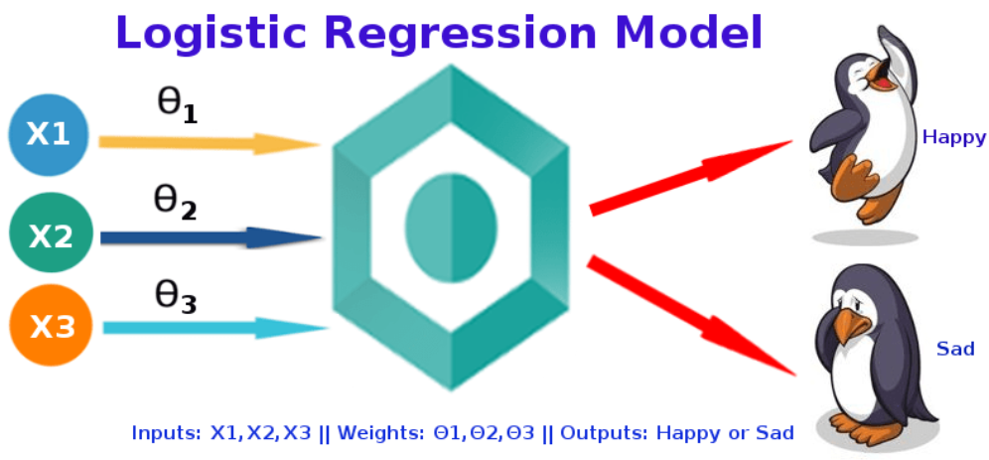
MODEL ARCHITECTURE
PICKLE

Slide 3








APPLICATION ARCHITECTURE
PICKLED MODEL

Slide 4





DEPLOYMENT ARCHITECTURE

Slide 5
CHALLANGES
Getting a Reliable News Source.
Extracting relevant tweets from twitter.
Extracting Location from tweets.
Ray Implementation.

Slide 6
REFERENCES
https://developers.google.com/apis-explorer/#p/
https://aylien.com/news-api/
https://developer.twitter.com/en/docs

